Slide 1

Awareness Programme For
Aspects Identification and
Impact Assessment

Slide 2
Environmental Aspects
Clause Ref : 6.1.2
The organization shall establish,implement and maintain a procedures
a) to identify the environmental aspects of its activities, product and service within the defined scope of the environmental management system that it control and those that it can influence taking into account planned or new development or new or modified activities,products and services,and
b) to determine those aspects that have or can have significant impacts on the environment (i.e. significant environmental aspects)

Slide 3
The organization shall document this information and keep it up to date.
The organization shall ensure that the significant environmental aspects are taken into account in establishing, implementing and maintaining its environmental management system.

Slide 4
Definition of Environmental Aspect
element of an organization's activities or products or services that can interact with the environment
Definition of Environment
Surroundings in which on organization operates, including air, water,land, natural resources,flora, fauna, humans, and their interrelation.

Slide 5
Definition of Environmental impact
any change to the environment whether adverse or beneficial , wholly or partially resulting from an organization,environmental aspects

Slide 6
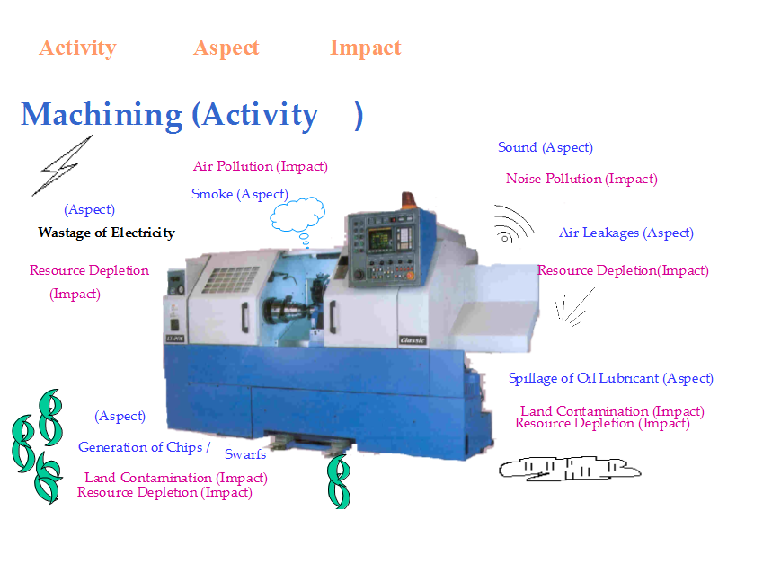

Slide 7
Activity Aspect Impact
Example : Car driving (activity).
Fuel Consumption (Aspect)
Resource Depletion(Impact)
Air pollution (Impact)
Noise pollution (Impact)
Engine sound (Aspect)
Emission (Aspect)
Engine oil spillage (Aspect)
Land /water contamination (Impact)

Slide 8
